Slide 1

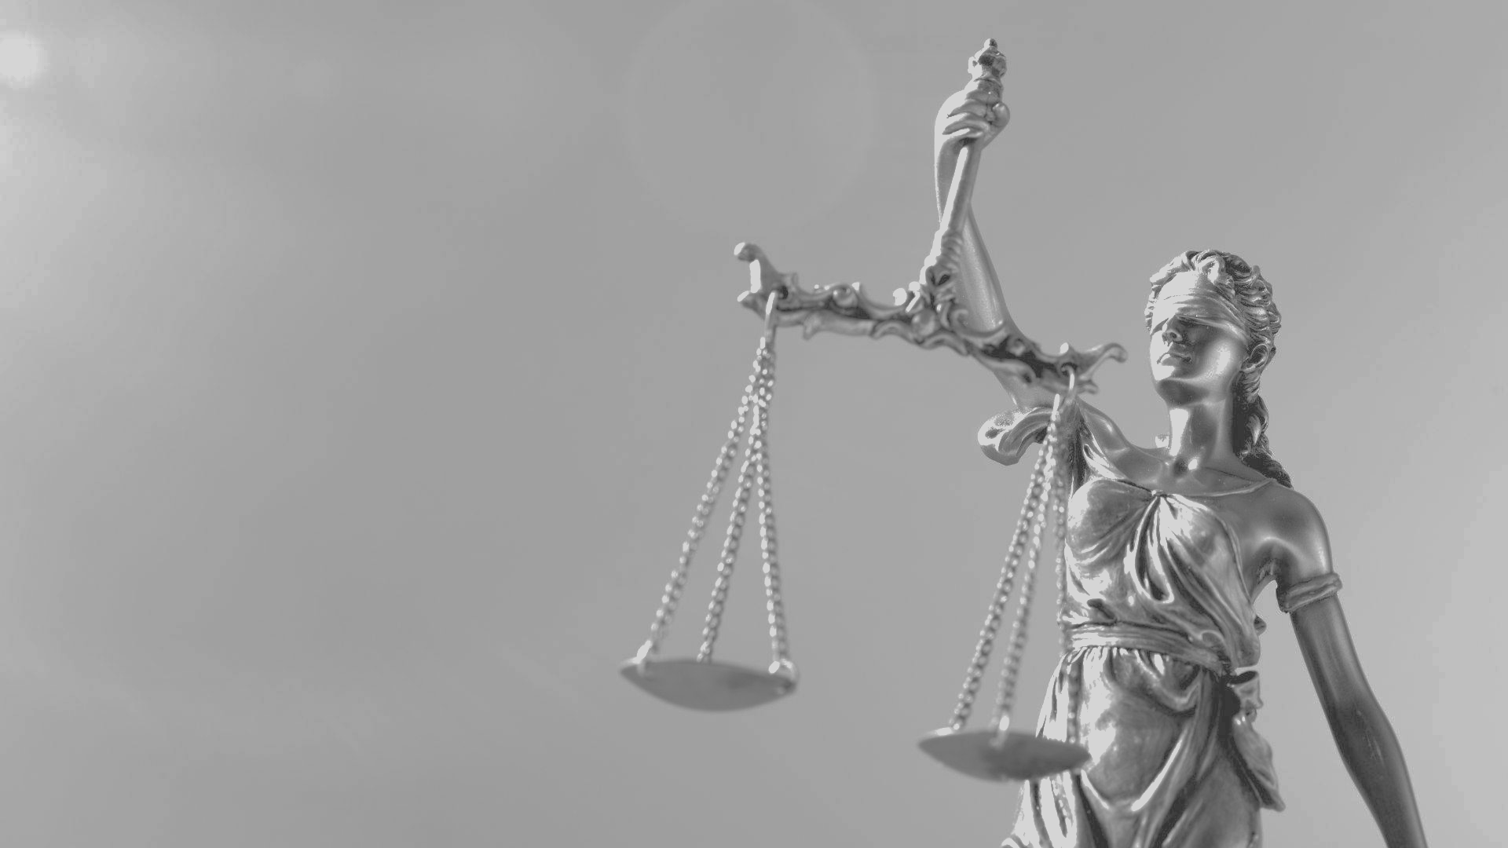
AI Fairness in the Criminal Justice System
Ashwin Kandath Vashishth Doshi Katelyn Wilson Satish Kumar Patchipulusu Junke Zhao
Notes:
Hi everyone, I’d like to present to you our work on AI fairness in the criminal justice system.

Slide 2
As AI takes on high-stakes decisions, analyzing fairness and bias is essential to ensure just outcomes
AI is being increasingly used to offload mental work at increasingly higher stakes, such as with granting or denying bail
This research is a culmination of our work and analyses conducted on 3 different county’s synthetic data
As we become increasingly reliant on AI, there will be a greater need to conduct analyses such as these to assess fairness and bias within these systems and address the problems they present
Notes:
AI is taking on increasingly high-stakes roles such as with granting or denying bail. This research is a culmination of our work and analyses conducted on three different counties’ synthetic data. Over time, we will become more and more reliant on AI and there will be an increasing need to assess the fairness and bias these systems exhibit and the problems they create.

Slide 3
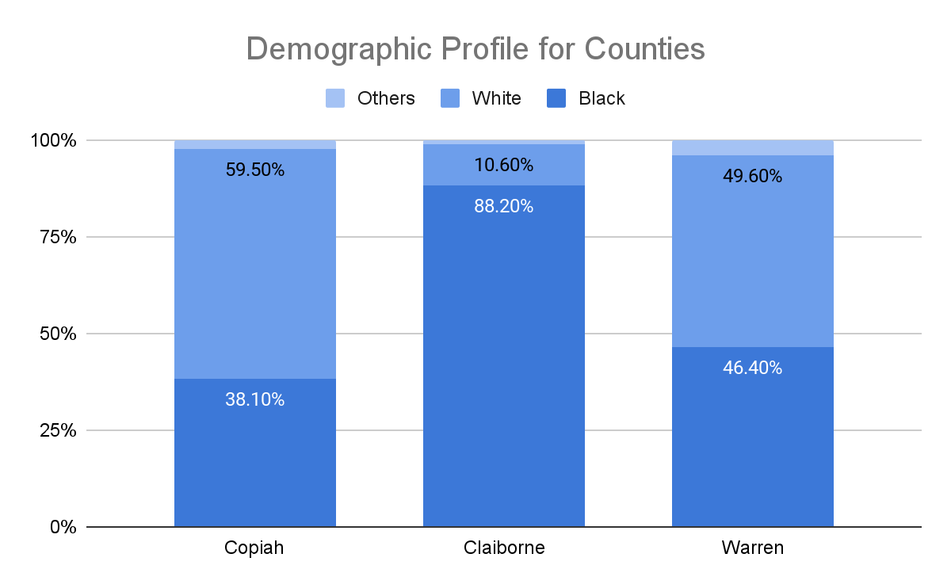
The three counties have different proportions of black, white and other races
Racial distribution across the counties are largely different
Copiah is mostly white
Claiborne is mostly black
Warren has a fairly even mix between the two predominant groups
Notes:
While assessing the racial distribution among the three counties, we notice that Copiah is white dominant, Claiborne is black dominant and Warren has a fairly even in terms of the white and black population

Slide 4
Apart from race, the distribution across other features are similar across counties
Outside of race, all counties had very similar distributions (within 1-3%) in:
Gender
Highest level of education completed
Economic status
Unemployment status
Income level
In theory, these counties should have equal impact when using the AI-based risk scores across all individuals when determining to grant or deny bail
Notes:
Non-racial factors like gender, education, economic status, unemployment, and income levels. If race is excluded as a feature from the dataset, the AI model should ideally be treating the individuals from these counties similarly when assessing risk, as the distributions of key socioeconomic factors are nearly identical. Therefore, in an unbiased system, these counties should have equal influence on the outcomes of the AI model's decisions.

Slide 5
However…

Slide 6
Risk scores vary across different races and are the highest for the black population
Assigned risk scores across racial demographics were very dissimilar
Average risk score per race:
White: 4.73
Other: 4.73
Black: 5.86 - over a full point higher!
Despite being similar across all other relevant factors, the black population received a higher risk score on average, which may imply the algorithm has trained on historical data
Notes:
Specifically, considering that all three counties have otherwise inherently different demographics, to have high risk assessment scores for black individuals, may imply that the ai is trained on data with bias and which is perpetuated via the tool.

Slide 7
Judges’ decision are more biased against the black population, showing disparate treatment
Judge decision by race trends similarly across all counties.
Bail decisions for black are denied beginning risk score = 4 for black populations v/s
Bail decisions for white are denied beginning risk score = 6 for white populations
This displays a disparate treatment
Risk Score' Average by 'Gender'
 | Female | Male | Grand Total
Average of Risk Score | 5.782 | 5.729 | 5.756

Slide 8
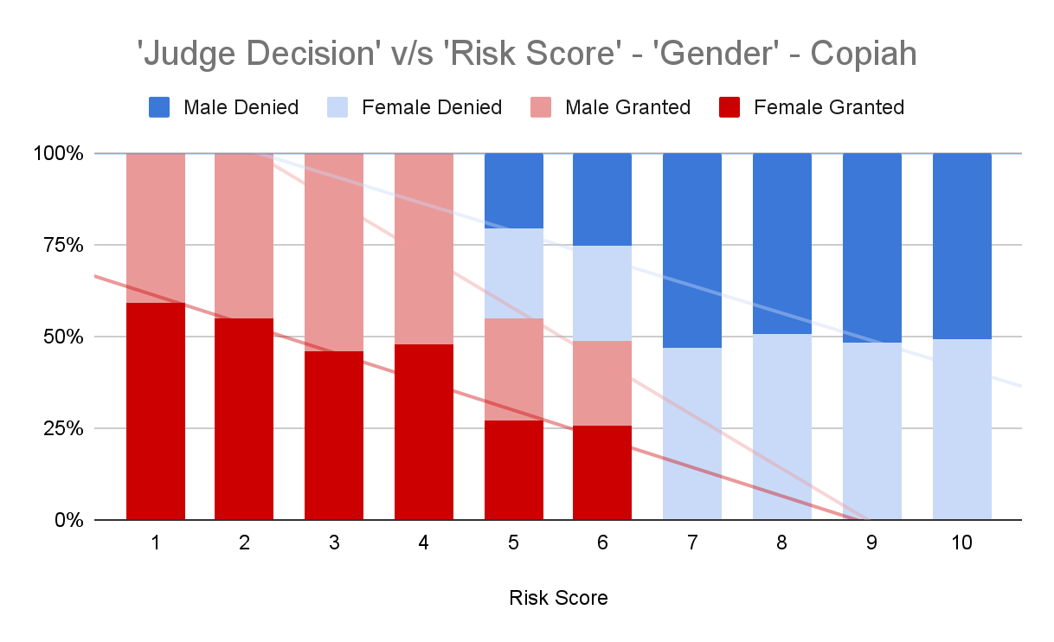
The judicial decisions across genders are symmetrical
This black marked line shows symmetric treatment of two different demographic groups.
This can be considered as normal, equal treatment by judges.
Copiah is an example, but this trend is common across all counties.

Slide 9
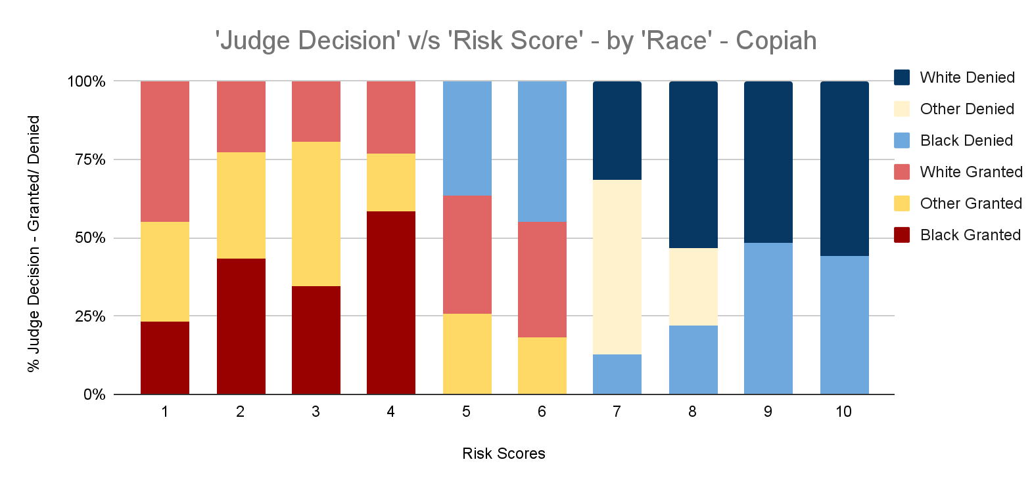
Judicial decisions across races have disparity
No symmetry in diagram shows a disparate treatment against black populations.
Deviates from a normal, equally representative treatment.
Copiah is an example, but this trend is common across all counties.

Slide 10
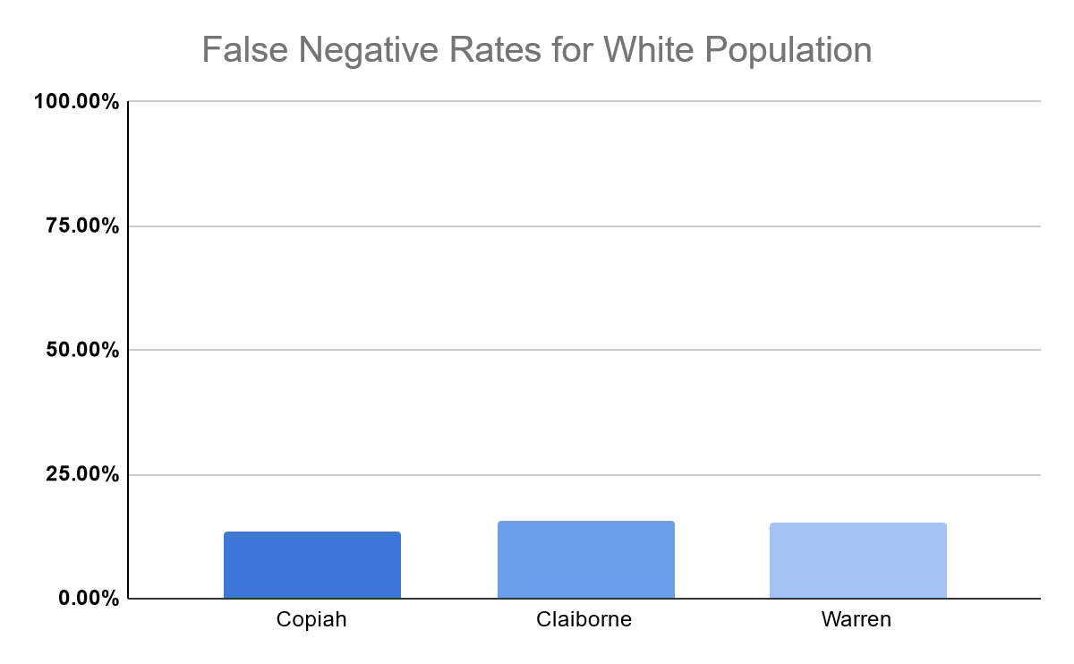
Low FNR among the ‘white’ population
The false negative rate for the white population is very low
Few white individuals are denied bail that will not re-offend
Implies the model is very accurate for this population

Slide 11
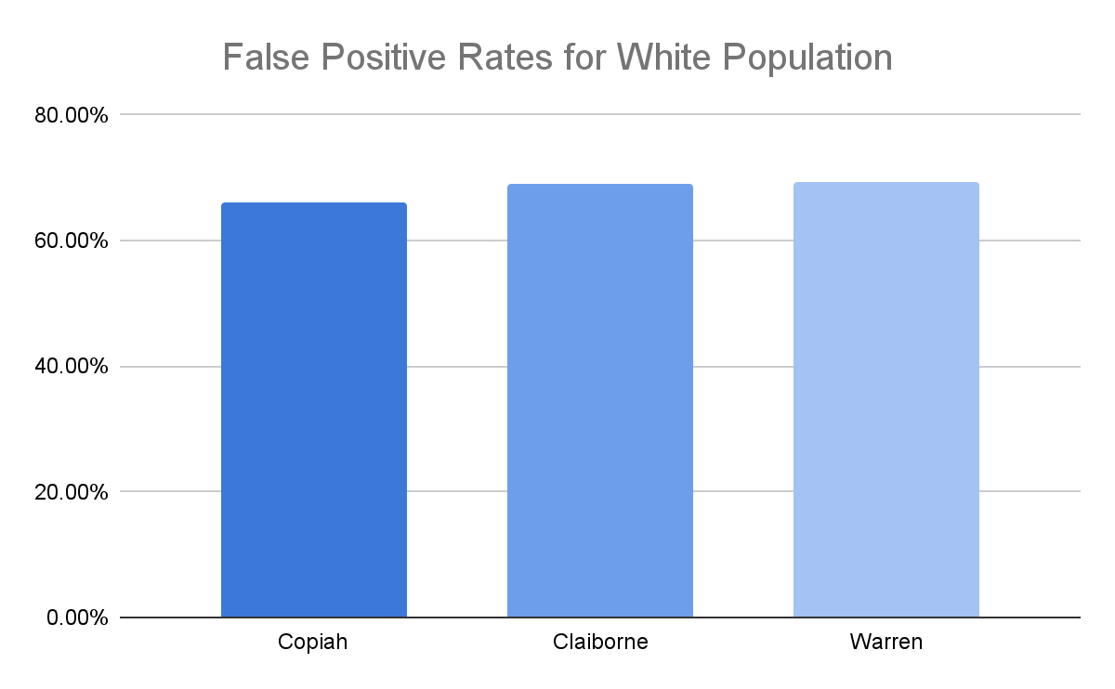
High FPR Highlights Model's Weakness in Predicting Re-Offenders for White Population
Unlike the false negative rate, the false positive rate is very high
White individuals are often mistakenly given bail when they will re-offend
The model is inherently poor at identifying re-offenders

Slide 12
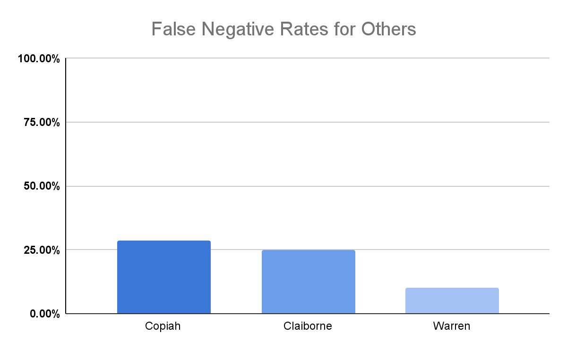
FNR for 'Other' Population: Comparable to White Demographic but Vary by County
The ‘other’ population is very small by comparison
The false negative rate is not very high
Copiah and Claiborne are higher than Warren due to their smaller population
Overall, relatively comparable to the white population

Slide 13
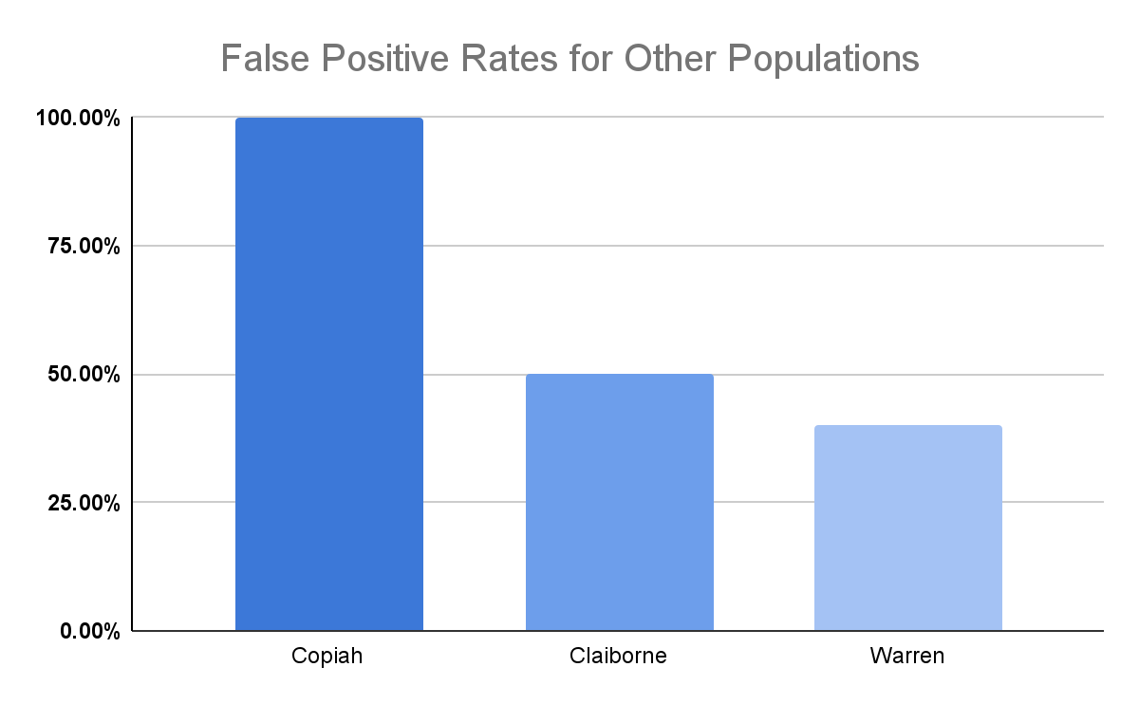
Skewed FPR for 'Other' Populations Due to Small Sample Size
The data for the ‘other’ population is skewed due to small population size
Copiah has the smallest portion of this demographic

Slide 14
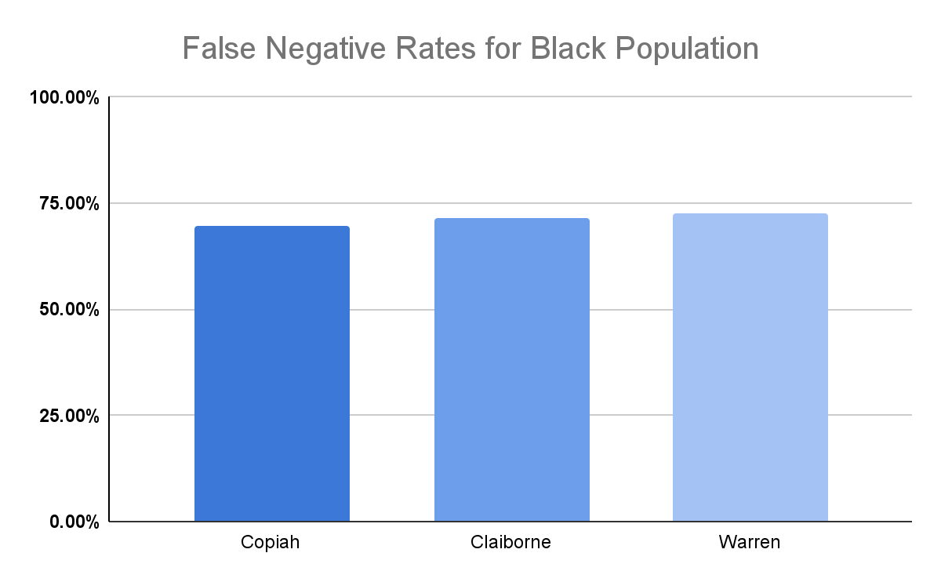
High FNRs: Model Bias for Black Population
Unlike the white and other populations, the FNR for the black population was much, much higher
Up over 50 percent for all counties when compared to the white population
This shows that the model is very poor at accurately identifying individuals who will re-offend

Slide 15
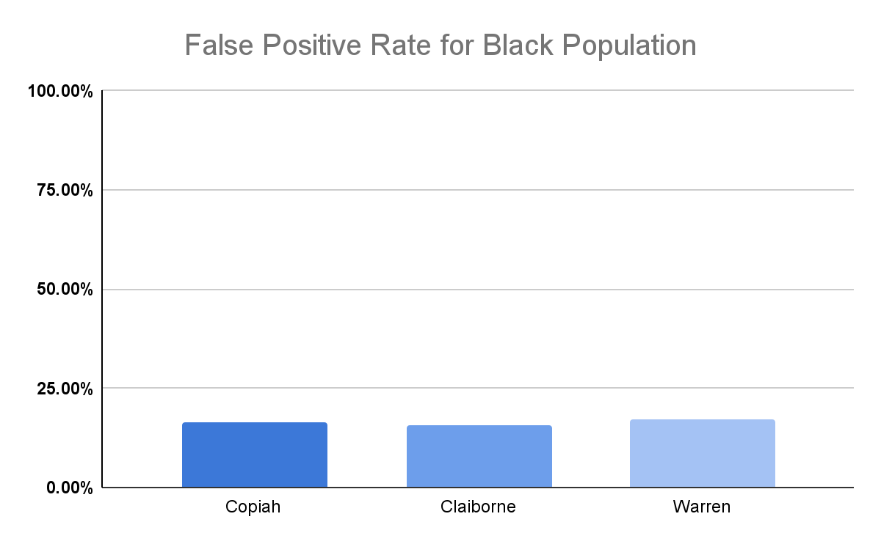
Low FPR Reveal Model's Failure to Identify Re-Offenders in Black Population
The false positive rate for the black population is very low
The model does a very poor job at identifying individuals who will re-offend
This results in many black individuals being jailed unfairly

Slide 16
The model fails on both fairness metrics: statistical parity and equal opportunity
Is the rate of bails granted independent of which county an individual belongs to?
Is the rate of bails granted to non-reoffenders consistent across counties?
Copiah
Warren
Copiah
Warren
Statistical Parity
Equal Opportunity
Claiborne
Claiborne

Slide 17
Biased FNR and FPR rates reveal unfair outcomes, with both model and judicial decisions lacking equity across groups
FNR is high for black populations irrespective of the county, which means that for a black person, they are more likely to be jailed when they don’t re-offend
FPR is high for white populations irrespective of the county, which means that for a white person, they are more likely to be given bail when they will re-offend
The model is not the only thing that is biased – judge decisions are also biased, as reflected in the data
No statistical parity or equal opportunity across any of the counties, which implies that the outcomes are not fair across population segments

Slide 18
Thank you!

Slide 19
Collaboration Log
Assembly and folder setup - Katelyn Data analysis framework - Katelyn Data analysis edits - Vashishth, Ashwin Copiah County - Ashwin, Vashishth Claiborne County - Katelyn Warren County - Satish, Junke Essay - Vashishth, Ashwin, Katelyn Essay editing - Katelyn Presentation - Vashishth, Ashwin, Satish, Katelyn

